Slide 1
Climate Change Linkages to Public Health in our community
UVI Caribbean Exploratory Research Center
2016 Institute
LaVerne E. Ragster, Ph.D.
CERC Research Associate
University of the Virgin Islands

Slide 2
Climate Change - our new world Environment
Climate Change : A long-term shift in the average weather
      measured by features such as temperature, wind patterns and precipitation
      of a location, region or planet
      includes a change in the variability of climate

Slide 3
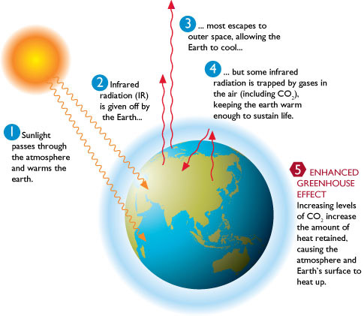
Climate Change - our new world Environment

Slide 4
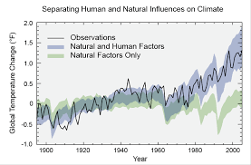
Climate Change - our new world Environment

Slide 5
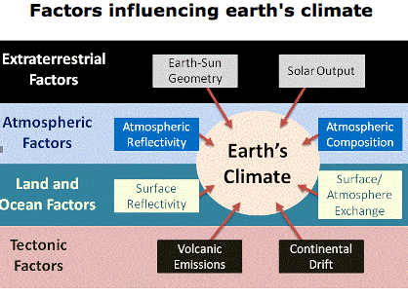
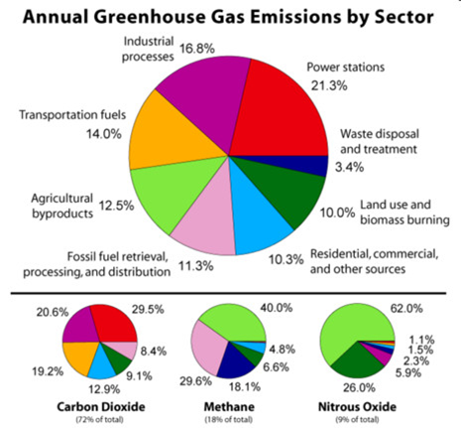
Climate Change - our new world Environment

Slide 6
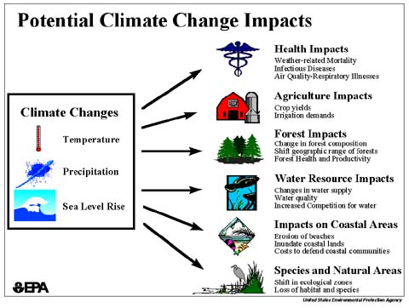
Climate Change - our new world Environment

Slide 7
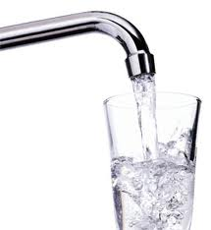
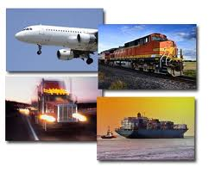
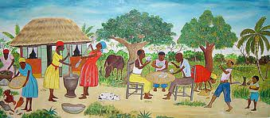
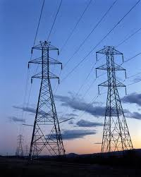
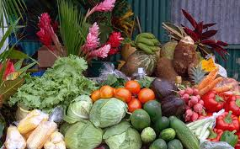
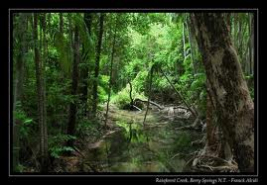
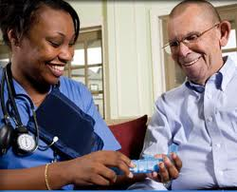
Everything is connected to climate
Transportation
Society
Water
Energy
Agriculture
Ecosystems
Health
Notes:
Direct – based mostly on exposure to weather extremes (extreme temperatures, floods, droughts, decreased air-quality)
Indirect- infectious diseases (person to person or by vector)
Vector can be biological or non-biological physical vehicle

Slide 8
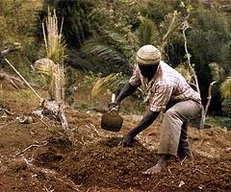
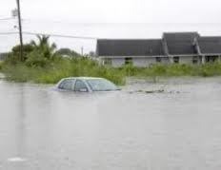
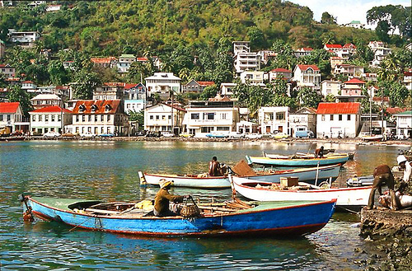
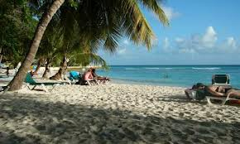
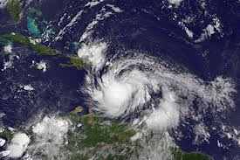
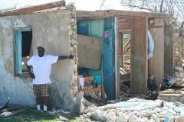
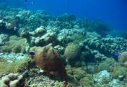
Climate Change Effects in the Caribbean
Increased Temperatures
Droughts and Flooding
Sea Level Rise
More Severe Storms and Hurricanes
Ocean Acidification

Slide 9
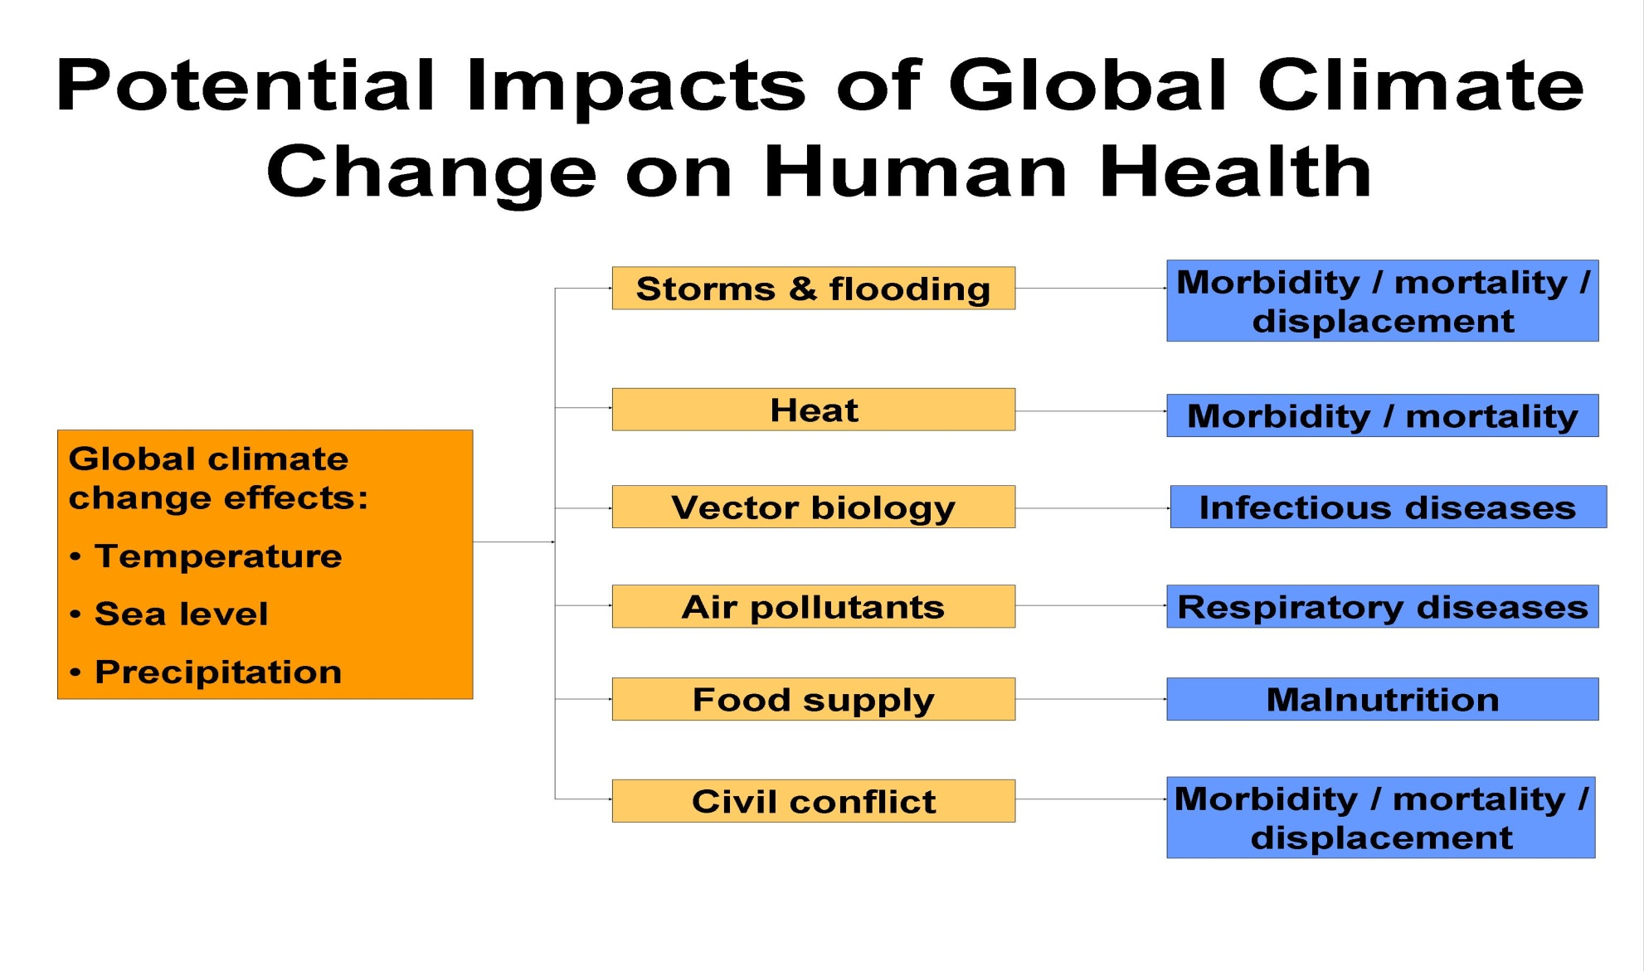
Notes:
Direct – based mostly on exposure to weather extremes (extreme temperatures, floods, droughts, decreased air-quality)
Indirect- infectious diseases (person to person or by vector)
Vector can be biological or non-biological physical vehicle
These types of graphs and information need to be seen in the context of increasing levels of non-communicable diseases in a number of Caribbean states and the compounded situation in some like JA and Trinidad where both communicable and non-communicable diseases are in the populations.

Slide 10
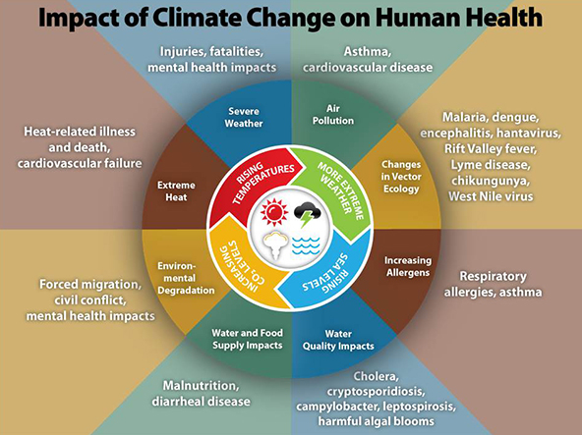
Climate Change - our new world Environment
Source: CDC

Slide 11
Threats to Human Health in the Caribbean
Intense Rainfall Events &
Higher Temperatures
Malaria
Respiratory Tract Infections
Leptospirosis
Diarrheal disease

Slide 12
Threats to Human Health in the Caribbean
Droughts and Higher Temperatures
Loss of food production malnutrition
Increased incidences of Dengue Fever & DHF, Chikungunya, Zika
Respiratory illnesses, asthma
Heat related illnesses (stroke, heat rash)
Ciguatera

Slide 13
Threats to Human Health in the Caribbean
Increased Storm Severity
Injuries and loss of life
Increased risk of water-borne and rodent borne diseases (e.g., typhoid and leptospirosis)

Slide 14
Climate Change could be Hazardous to your Health
Degraded Air quality
Increased intensity in hurricanes and storms
Flooding
Drought
Sea-level rise
Sea-level rise
Heat waves
Asthma
HIV/AIDS
Obesity
Cancer
Diabetes
Cardiovascular disease and Stroke

Slide 15
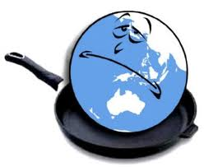
As our world becomes sicker - What will you do?
How do we reduce the negative impacts (mitigate) or learn to live with (adapt) to the way climate will change the world?

Slide 16
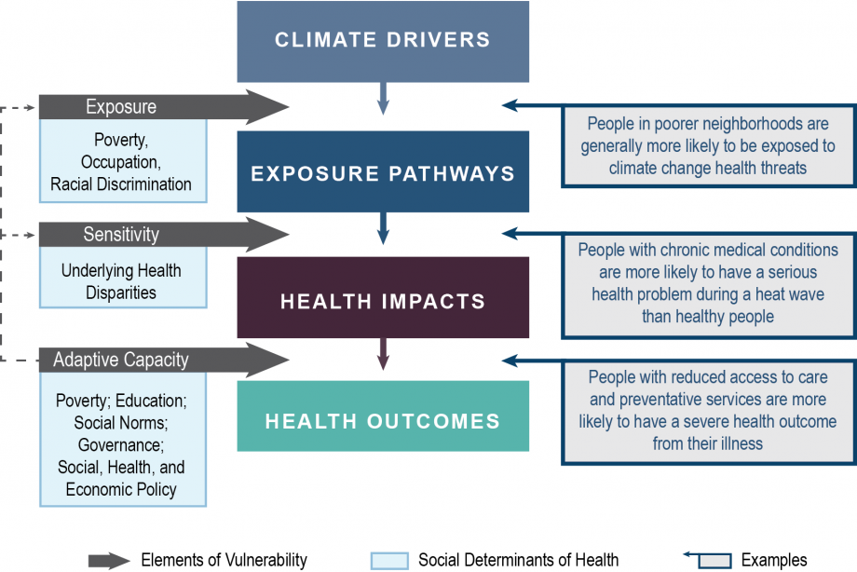
Climate Change adaptation requires Assessment

Slide 17
It is time to assess our state of readiness at the institutional and community levels to ensure good public health in a changing, more hostile environment. Thank you for your contributions to this critical process in support of a better future for the Virgin Islands.

Slide 18

Thank you !

